Slide 1
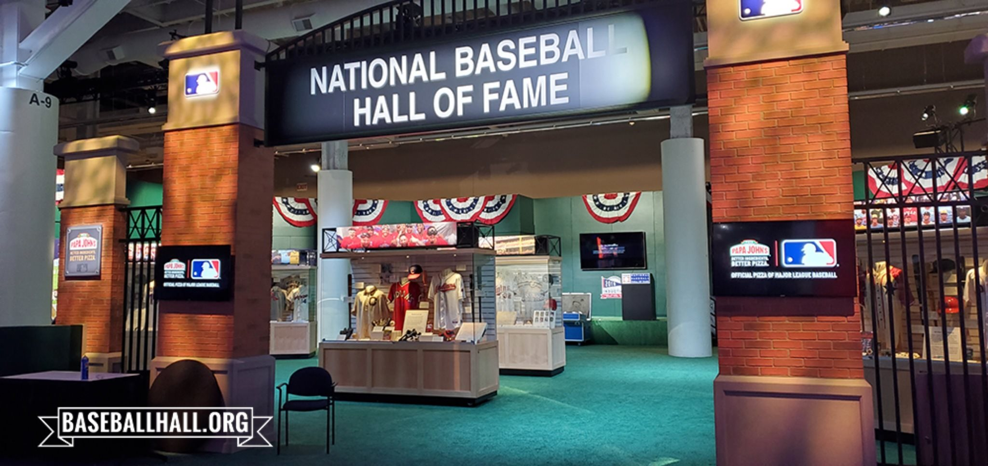
WHO WILL LOGISTICALLY
GET INTO THE

Slide 2
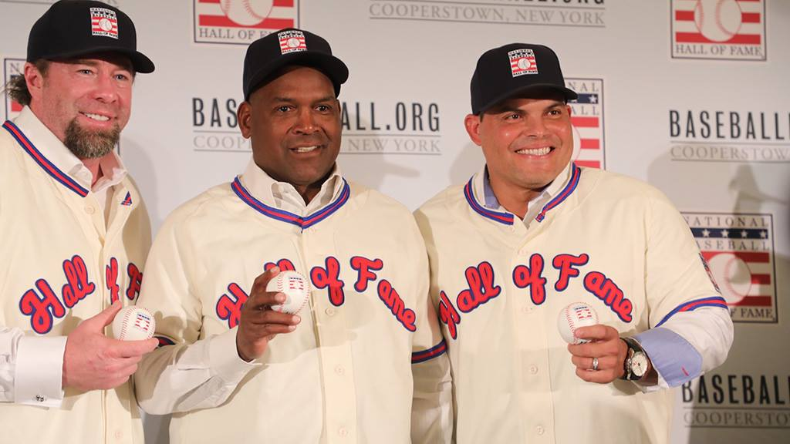
226
PLAYERS
IN HALL
~1% OF ALL
PLAYERS IN
HISTORY
1st
BASEMAN
CATCHER
LEFT FIELDER

Slide 3
Who will make it in out of those
not yet on ballots?
Logistic regression may give us
answers!

Slide 4

Our incomparable source!

Slide 5
1793 Players
297 Catchers
190 1st Basemen
211 2nd Basemen
209 3rd Basemen
217 Shortstops
243 Left Fielders
219 Center Fielders
207 Right Fielders

Slide 6
STATISTICS USED
SB
CS
BB
SO
BA
OBP
SLG
OPS+
PSTN
Yrs
ASG
G
R
H
2B
3B
HR
RBI
--------------------------
HOF

Slide 7
Logit 1
glm(HOF~Yrs+ASG+G+R+H+DBLS+TRPLS+HR+RBI+SB+CS+BB+SO+BA+OBP+SLG+OPSPLUS+PSTN, data=HOF_Eligible_Players, family="binomial")

Slide 8
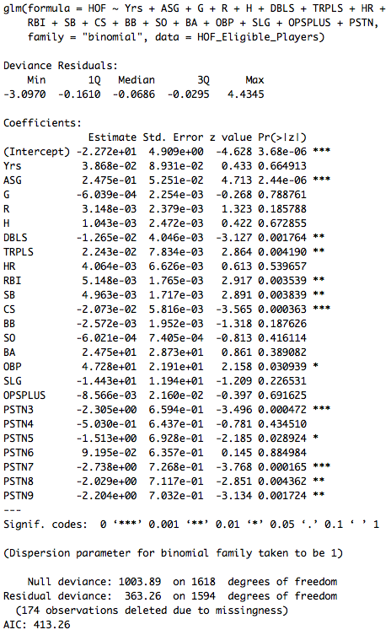

Slide 9
Logit 2
glm(HOF~ASG+R+H+DBLS+TRPLS+HR+RBI+SB+CS+BB+SO+BA+OBP+SLG+OPSPLUS+PSTN , data=HOF_Eligible_Players, family="binomial")

Slide 10
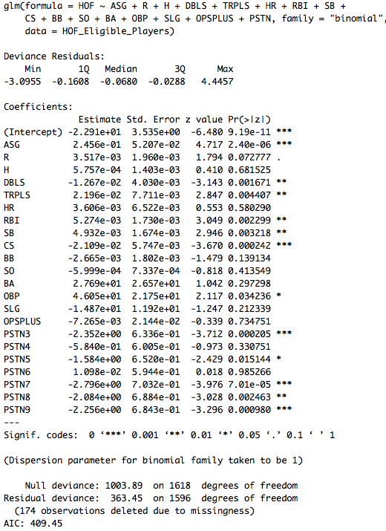

Slide 11
Logit 3
glm(HOF~ASG+R+DBLS+TRPLS+HR+RBI+SB+CS+BB+SO+BA+OBP+SLG+OPSPLUS+PSTN , data=HOF_Eligible_Players, family="binomial")

Slide 12
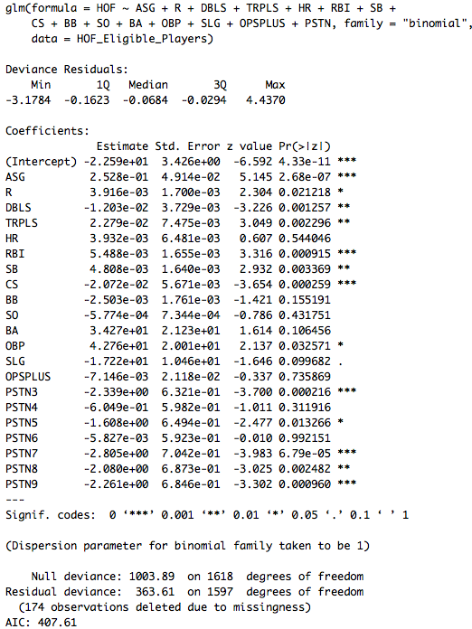

Slide 13
Logit 4
glm(HOF~ASG+R+DBLS+TRPLS+RBI+SB+CS+BB+SO+BA+OBP+SLG+OPSPLUS+PSTN , data=HOF_Eligible_Players, family="binomial")

Slide 14
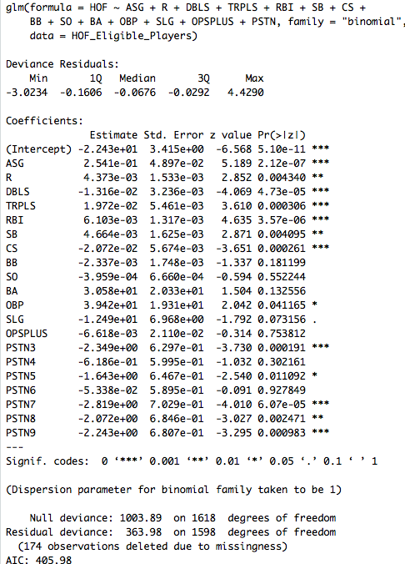

Slide 15
Logit 5
glm(HOF~ASG+R+DBLS+TRPLS+RBI+SB+CS+BB+SO+BA+OBP+SLG+PSTN , data=HOF_Eligible_Players, family="binomial")

Slide 16
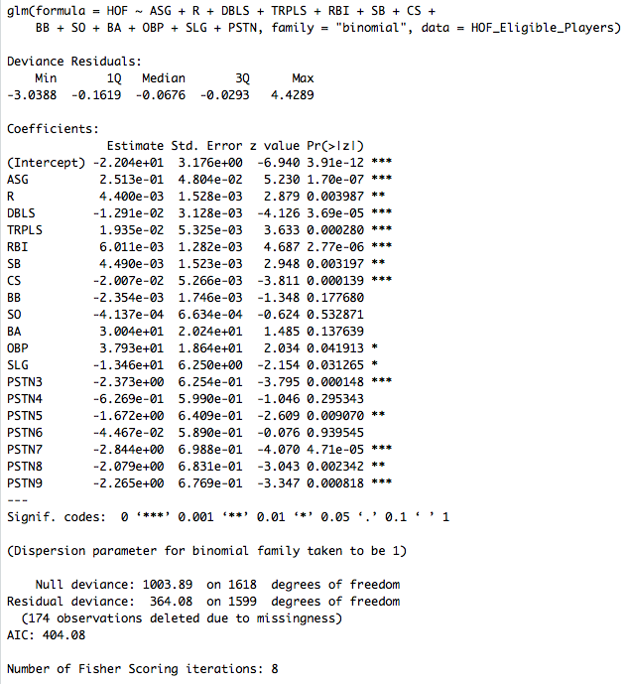

Slide 17
Logit 6
glm(HOF~ASG+R+DBLS+TRPLS+RBI+SB+CS+BB+BA+OBP+SLG+PSTN, data=HOF_Eligible_Players, family="binomial")

Slide 18
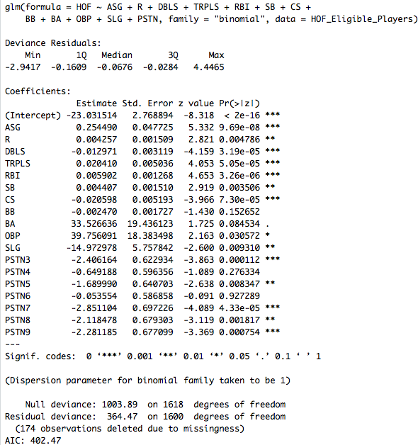

Slide 19
Logit 7
glm(HOF~ASG+R+DBLS+TRPLS+RBI+SB+CS+BA+OBP+SLG+PSTN , data=HOF_Eligible_Players, family="binomial")

Slide 20
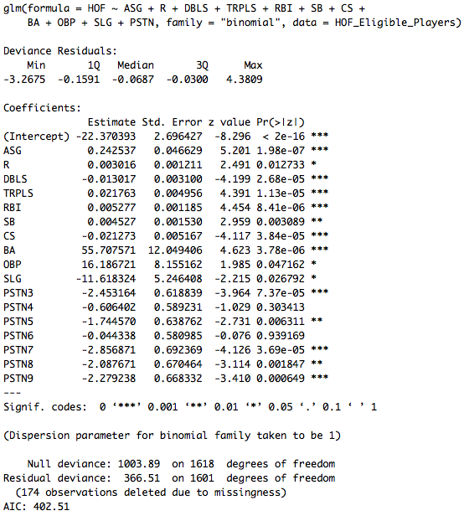

Slide 21
Logit 8
glm(HOF~ASG + R + DBLS + TRPLS + RBI + SB + CS + BB + OBP + SLG + PSTN , data=HOF_Eligible_Players, family="binomial")

Slide 22
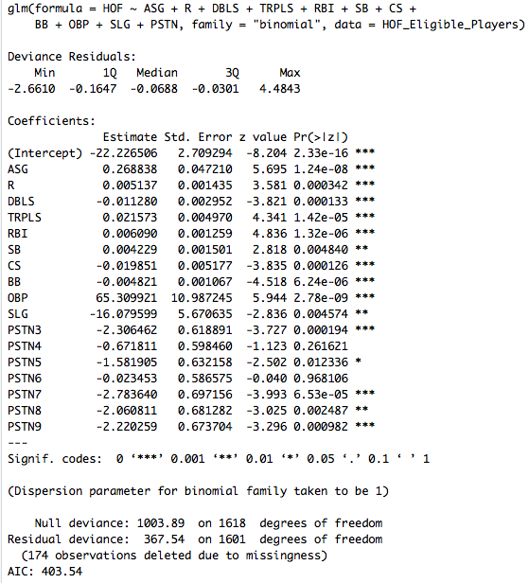

Slide 23
Logit 9
glm(HOF~ASG+R+DBLS+TRPLS+RBI+SB+CS+BB+BA+OBP+SLG data=HOF_Eligible_Players, family="binomial")

Slide 24
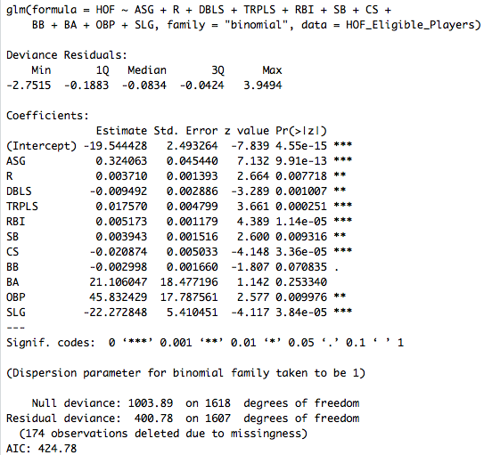

Slide 25
*WINNER*

Slide 26
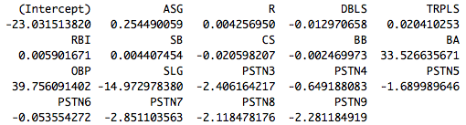
COEFFICIENTS

Slide 27
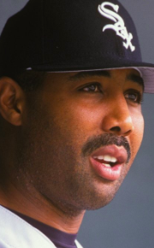
???????

Slide 28
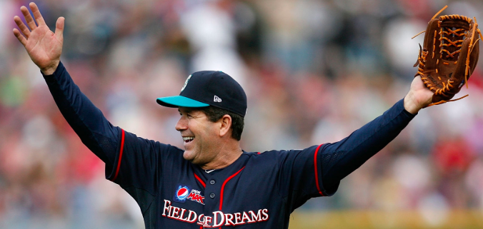
!!!!!

Slide 29
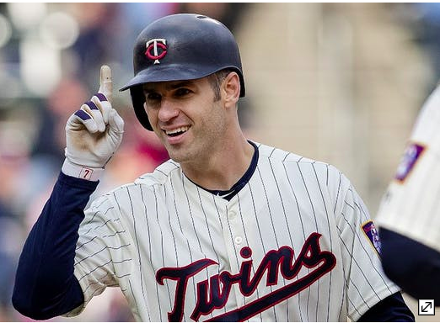

Slide 30
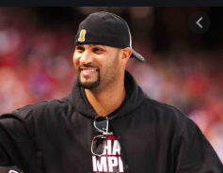
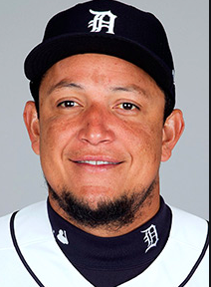
Miguel Cabrera

Slide 31

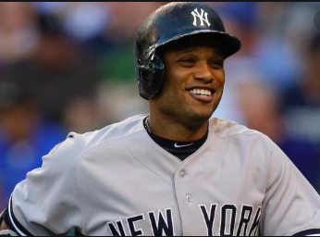

Slide 32
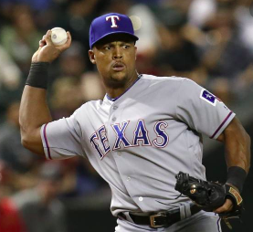

Slide 33
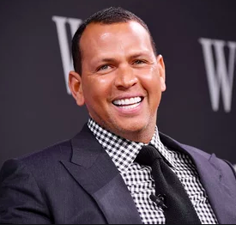
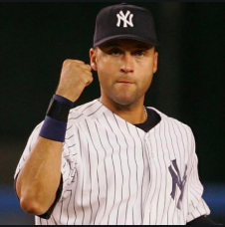

Slide 36
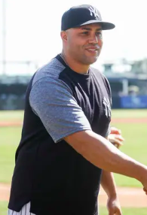
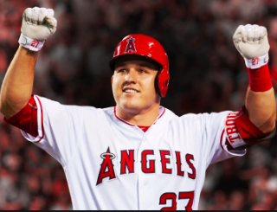

Slide 38
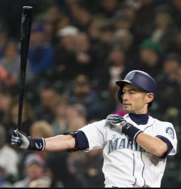

Slide 39
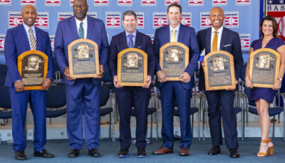

Slide 40
REVISIONS

Slide 41
Used as a starting point the arguably best model from earlier.
*NEW WINNER*

Slide 42
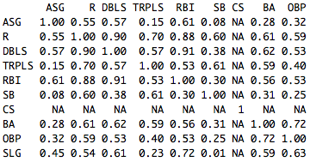
Took the advice of exploring correlation to see why doubles and slugging percentage have negative coefficients. Doubles is highly correlated with runs and triples so it comes out.

Slide 43
Logit 10
glm(HOF~ASG+R+TRPLS+RBI+SB+CS+BA+OBP+SLG+PSTN, data=HOF_Eligible_Players, family="binomial”)

Slide 44
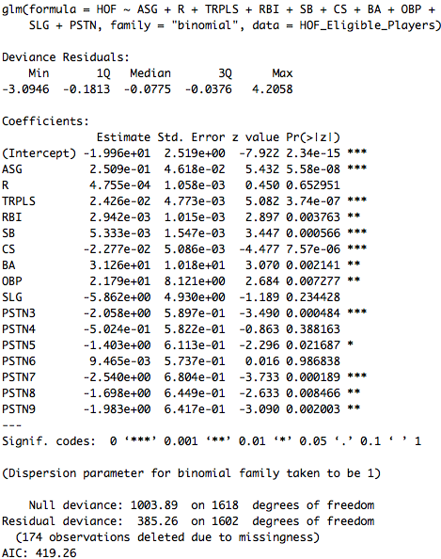
Looking at the large AIC and how some variables are no longer significant at all, doubles should go back in.

Slide 45
*STILL
THE
WINNER*

Slide 46
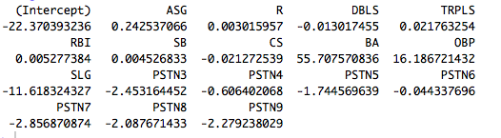
NEW COEFFICIENTS

Slide 48
Miguel Cabrera

Slide 57
Final Thoughts
The slides with the revisions didn’t look much different than the originals, unsurprising given how close the AIC was.
Thanks for suggesting looking into correlation. Even though I didn’t gain anything from that, I feel more sophisticated analysis might lend some insight.
This was a wonderful class. I hope it gets me that six-figure movie studio/TV network job for which I’ve long dreamed!

